Slide 1
SQL
Structured Query Language

Slide 2
SQL er et standard sprog for at gemme, manipulere og hente data fra databaser

Slide 3
SQL can execute queries against a database
SQL can retrieve data from a database
SQL can insert records in a database
SQL can update records in a database
SQL can delete records from a database
SQL can create new databases
SQL can create new tables in a database
SQL can create stored procedures in a database
SQL can create views in a database
SQL can set permissions on tables, procedures, and views

Slide 4
Database
En database består af en eller flere tabeller
Hver tabel består af en eller flere rækker - records

Slide 5
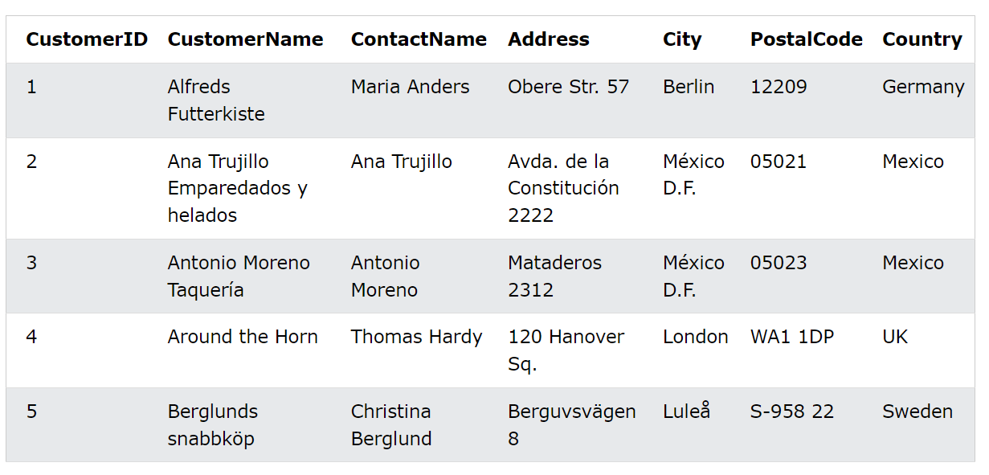
Eksempel på tabel fra w3schools

Slide 6
Hente data fra tabeller
Syntaks rækkefølge:
select
from
where
group by
having
order by
Logisk rækkefølge:
from
where
group by
having
select
order by

Slide 7
Logisk rækkefølge
from: hvilke tabeller indeholder de data vi skal bruge
where: betingelser for at rækker skal med
group by: gruppering af data
having: betingelser for hver gruppe
select: hvilke kolonner skal med
order by: hvilken rækkefølge

Slide 8
select, select distinct
from
where
order by

Slide 9
SELECT column1, column2, ...
FROM table_name;
SELECT * FROM table_name;
SELECT DISTINCT column1, column2, ...
FROM table_name;
SELECT column1, column2, ...
FROM table_name
WHERE condition;
SELECT column1, column2, ...
FROM table_name
ORDER BY column1, column2, ... ASC|DESC;

Slide 10
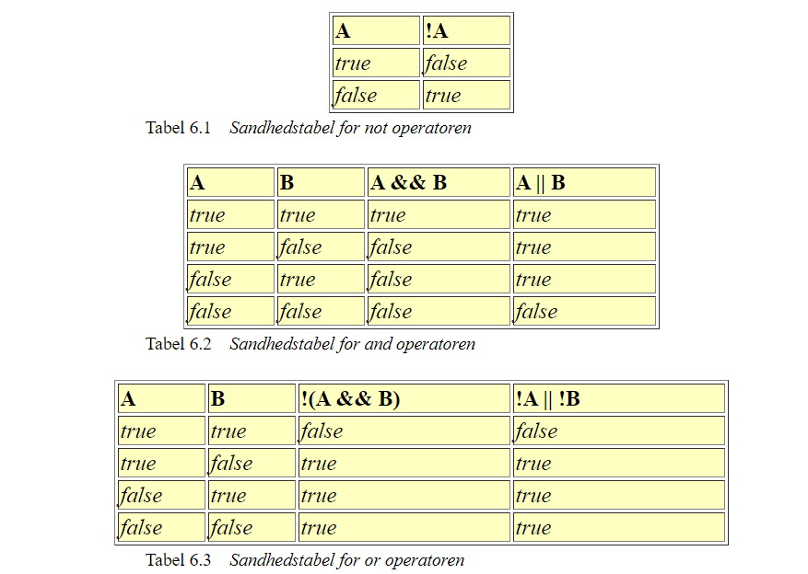
Logiske operatorer AND - OR - NOT

Slide 11
SELECT column1, column2, ...
FROM table_name
WHERE condition1 AND condition2 AND condition3 ...;
SELECT column1, column2, ...
FROM table_name
WHERE condition1 OR condition2 OR condition3 ...;
SELECT column1, column2, ...
FROM table_name
WHERE NOT condition;

Slide 12
Aggregerings Funktioner
Min
Max
Count
Avg
Sum

Slide 13
SELECT MIN(column_name)
FROM table_name
WHERE condition;
SELECT MAX(column_name)
FROM table_name
WHERE condition;
SELECT COUNT(column_name)
FROM table_name
WHERE condition;
SELECT AVG(column_name)
FROM table_name
WHERE condition;
SELECT SUM(column_name)
FROM table_name
WHERE condition;

Slide 14
SQL Aliases
Benyttes til at give en tabel eller en kolonne et midlertidigt navn
SELECT column_name AS alias_name
FROM table_name;
SELECT o.OrderID, o.OrderDate, c.CustomerName
FROM Customers AS c, Orders AS o
WHERE c.CustomerName='Around the Horn' AND c.CustomerID=o.CustomerID;

Slide 15
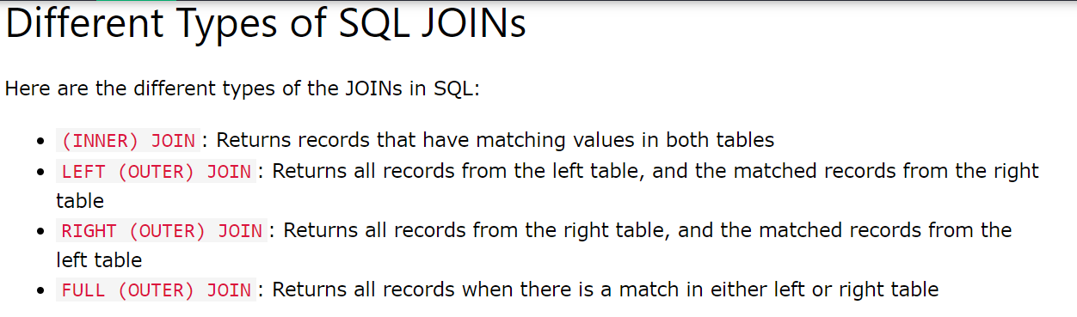
SQL Joins

Slide 16
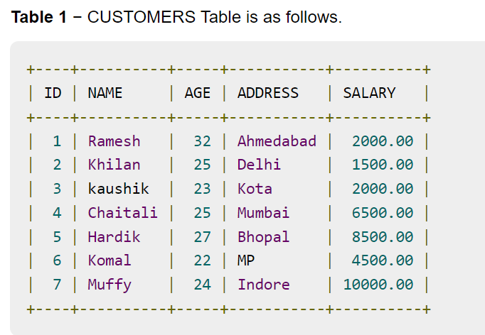
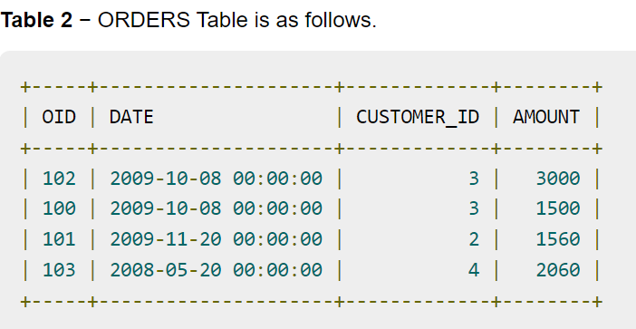

Slide 17
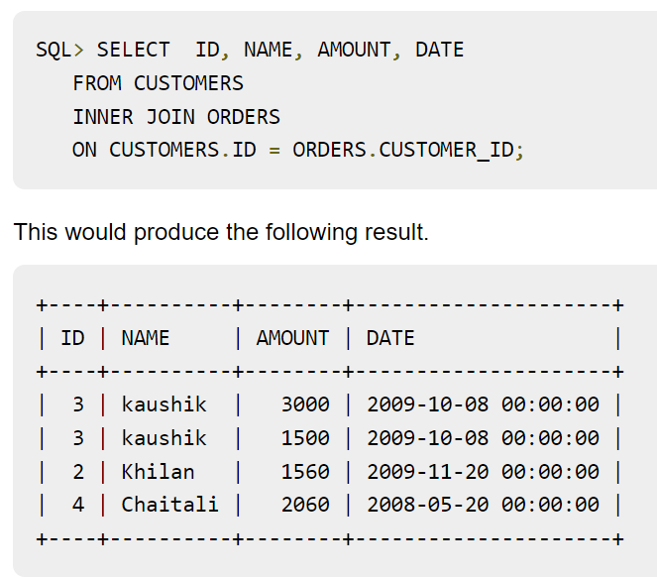

Slide 18
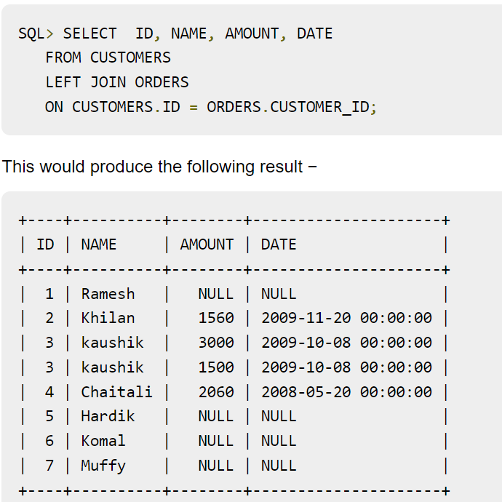

Slide 19
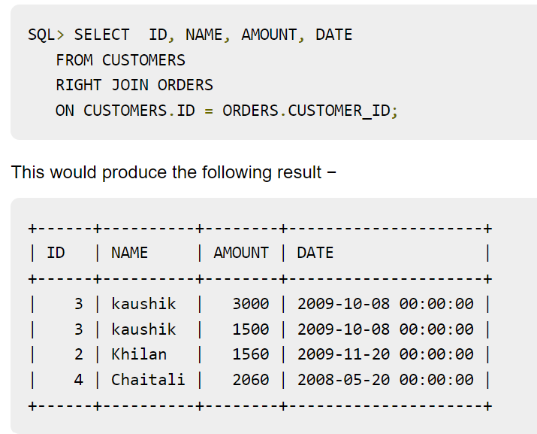

Slide 20
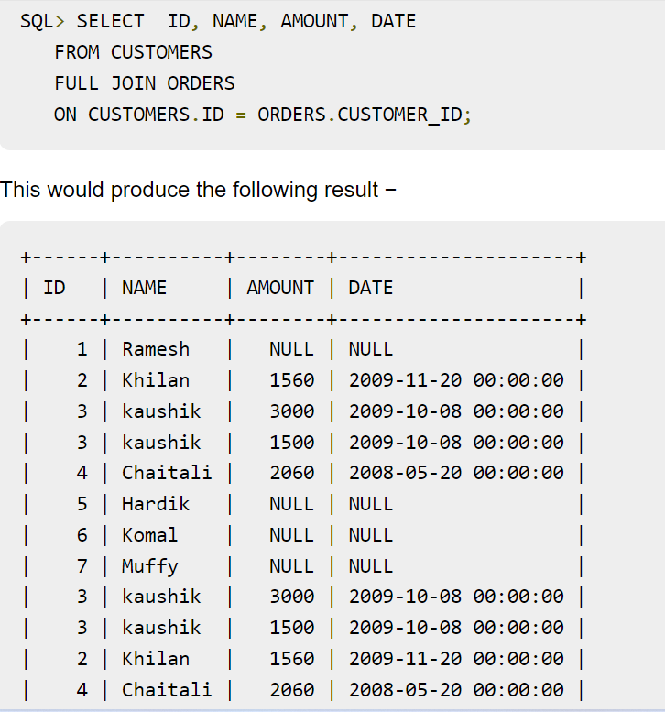

Slide 21
Inner join
SELECT column_name(s)
FROM table1
INNER JOIN table2
ON table1.column_name = table2.column_name;
SELECT Orders.OrderID, Customers.CustomerName
FROM Orders
INNER JOIN Customers ON Orders.CustomerID = Customers.CustomerID;

Slide 22
Left join
SELECT column_name(s)
FROM table1
LEFT JOIN table2
ON table1.column_name = table2.column_name;
SELECT Customers.CustomerName, Orders.OrderID
FROM Customers
LEFT JOIN Orders ON Customers.CustomerID = Orders.CustomerID
ORDER BY Customers.CustomerName;

Slide 23
Right join
SELECT column_name(s)
FROM table1
RIGHT JOIN table2
ON table1.column_name = table2.column_name;
SELECT Orders.OrderID, Employees.LastName, Employees.FirstName
FROM Orders
RIGHT JOIN Employees ON Orders.EmployeeID = Employees.EmployeeID
ORDER BY Orders.OrderID;

Slide 24
Full outer join
SELECT column_name(s)
FROM table1
FULL OUTER JOIN table2
ON table1.column_name = table2.column_name
WHERE condition;
SELECT Customers.CustomerName, Orders.OrderID
FROM Customers
FULL OUTER JOIN Orders ON Customers.CustomerID=Orders.CustomerID
ORDER BY Customers.CustomerName;

Slide 25
SQL GROUP BY
Grupperer rækker som har samme værdi på et givet felt/kolonne
Benyttes ofte sammen med aggregerings funktioner, min, max, avg, sum og count
SELECT column_name(s)
FROM table_name
WHERE condition
GROUP BY column_name(s)
ORDER BY column_name(s);

Slide 26
Eksempler group by
SELECT COUNT(CustomerID), Country
FROM Customers
GROUP BY Country;
SELECT COUNT(CustomerID), Country
FROM Customers
GROUP BY Country
ORDER BY COUNT(CustomerID) DESC;
SELECT Shippers.ShipperName, COUNT(Orders.OrderID) AS NumberOfOrders FROM Orders
LEFT JOIN Shippers ON Orders.ShipperID = Shippers.ShipperID
GROUP BY ShipperName;

Slide 27
SQL HAVING
Having knytter sig til group by og aggregerings funktioner
SELECT column_name(s)
FROM table_name
WHERE condition
GROUP BY column_name(s)
HAVING condition
ORDER BY column_name(s);

Slide 28
Eksempel sql Having
SELECT COUNT(CustomerID), Country
FROM Customers
GROUP BY Country
HAVING COUNT(CustomerID) > 5;
SELECT COUNT(CustomerID), Country
FROM Customers
GROUP BY Country
HAVING COUNT(CustomerID) > 5
ORDER BY COUNT(CustomerID) DESC;

Slide 29
SQL IN Operator
SELECT column_name(s)
FROM table_name
WHERE column_name IN (value1, value2, ...);
SELECT column_name(s)
FROM table_name
WHERE column_name IN (SELECT STATEMENT);

Slide 30
Eksempler på IN operator
SELECT * FROM Customers
WHERE Country IN ('Germany', 'France', 'UK');
SELECT * FROM Customers
WHERE Country NOT IN ('Germany', 'France', 'UK');
SELECT * FROM Customers
WHERE Country IN (SELECT Country FROM Suppliers);

Slide 31
SQL EXISTS Operator
Benyttes for at teste om et subquery giver mindst 1 record
SELECT column_name(s)
FROM table_name
WHERE EXISTS
(SELECT column_name FROM table_name WHERE condition);

Slide 32
Eksempler på EXIST operator
SELECT SupplierName
FROM Suppliers
WHERE EXISTS (SELECT ProductName FROM Products WHERE Products.SupplierID = Suppliers.supplierID AND Price < 20);
SELECT SupplierName
FROM Suppliers
WHERE EXISTS (SELECT ProductName FROM Products WHERE Products.SupplierID = Suppliers.supplierID AND Price = 22);

